Slide 1



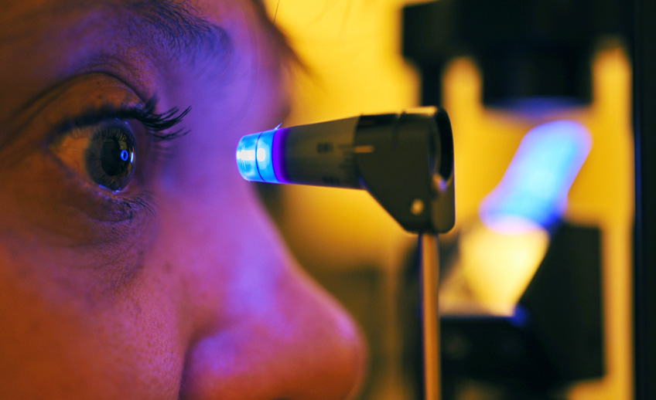

CSYE-7105 High Performance Computing Machine Learning & AI, Spring 2025
Project Presentation
Analysis of Efficient Parallel Computing for Deep Learning Based Glaucoma Detection
Instructor Name : Dr. Handan Liu
Team 4 : Ram Kumar Ramasamy Pandiaraj
Northeastern University

Slide 2
Table of contents
01
02
Introduction
Methodology
03
04
Conclusion
Analysis and Results

Slide 3

01
Introduction
Background, Motivation, Goal

Slide 4
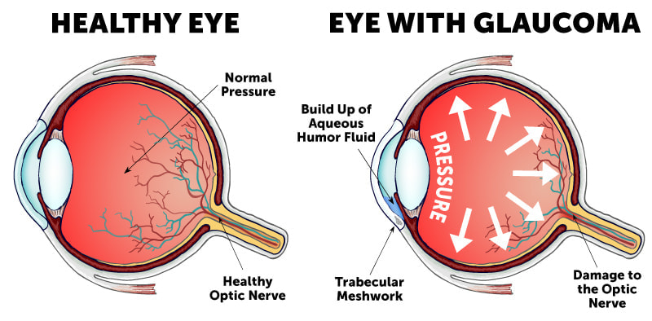
Introduction – Background
What is Glaucoma?
Progressive eye disease leading to blindness
Affects millions globally
Early detection is critical
Problem with Traditional Methods
Time-consuming
Requires expert ophthalmologists
Limited scalability, especially in underdeveloped areas
AI for Glaucoma Detection
Deep Learning (CNNs) for automating image analysis
Enhances diagnostic accuracy
Reduces time spent on image analysis

Slide 5
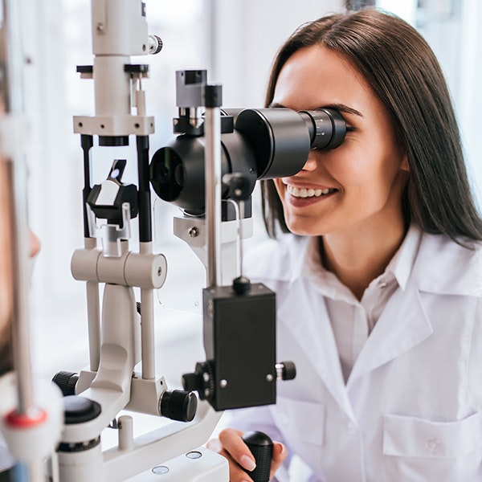
Introduction - Motivation
Need for Efficient Detection
Global rise in glaucoma cases
Traditional methods are slow, requiring more healthcare professionals
AI can scale detection efforts
Challenges in AI/Deep Learning
Large datasets (medical images)
Long training times for deep learning models
Requires optimization for faster results

Slide 6
Introduction – Main Goals
1. Develop a Deep Learning CNN Model for Glaucoma Detection from scratch
2. Optimize Training Performance Using Parallelization Techniques
3. Evaluate Performance Across Different CPU/GPU Configurations with different parallelization techniques.

Slide 7

02
Methodology
Dataset Description, Data preprocessing, Model Architecture, Parallelization Techniques

Slide 8
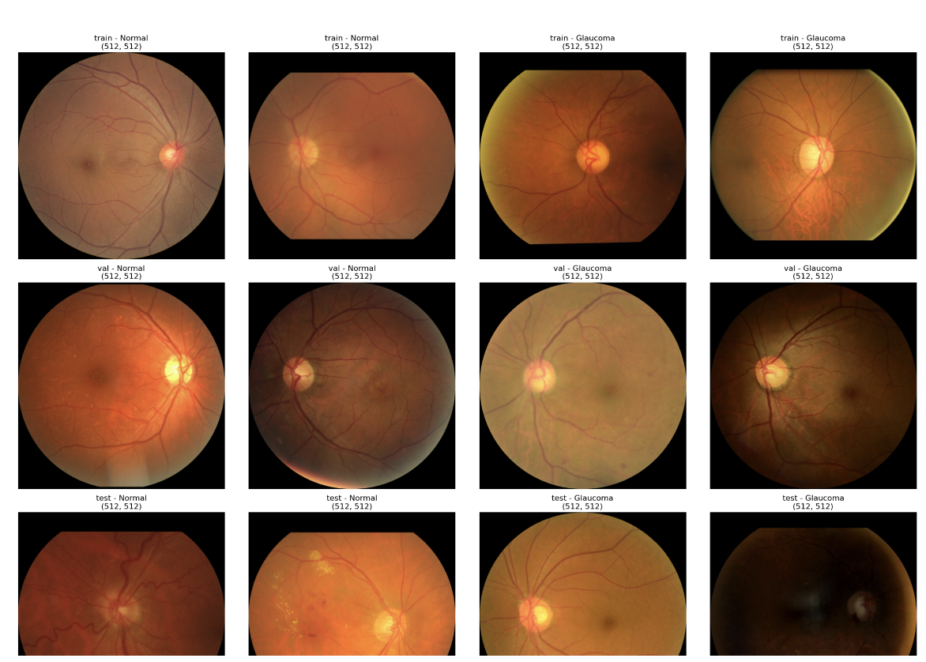
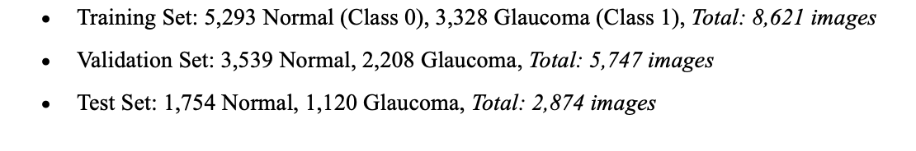
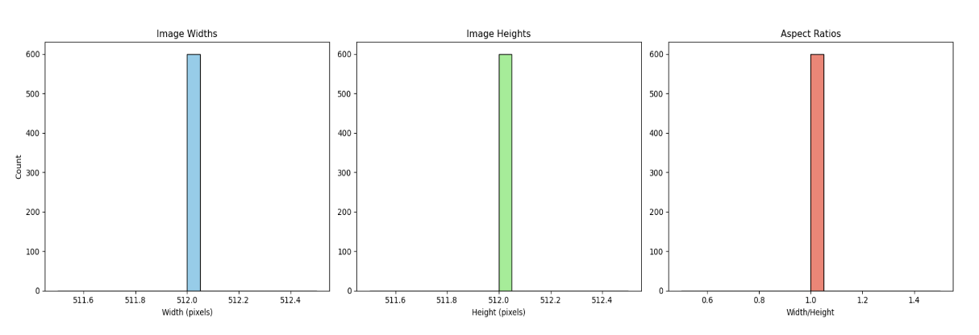
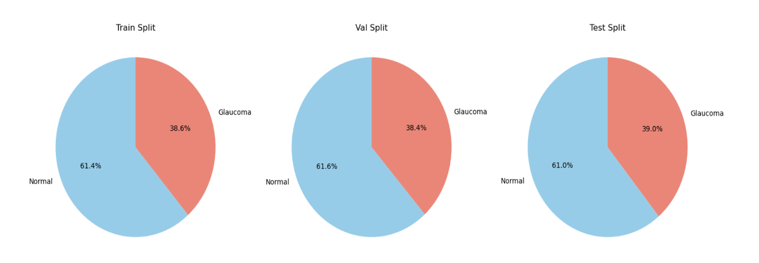
Methodology – Dataset Description
SMDG Image Dataset
2 classes – Normal , Glaucoma
17,242 high-resolution color fundus images
Images suited for Pytorch training
Total size: 4.1GB

Slide 9

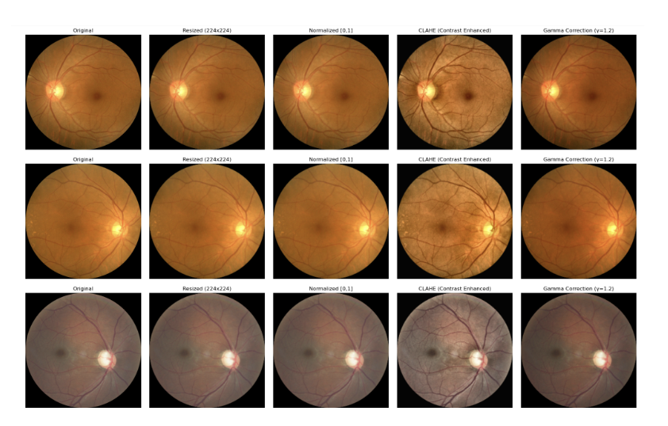
Methodology - Data Preprocessing
1. Resizing (e.g., 224x224 pixels
2. Normalization: Scaled pixel values to the range [0, 1] by dividing by 255.
3. Image Enhancement: Used contrast adjustments and sharpening. – CLAHE
4. Gamma Correction: brightness of the images
5. Data Augmentation: Rotation, flipping, and zooming, Random cropping and padding
6. Data Format: Converted images into numpy arrays for compatibility with the deep learning model
7. Label Encoding: Encoded categorical labels (healthy, glaucoma) as integers (0, 1).
Original → Resized → Normalized → CLAHE → Gamma Correction

Slide 10
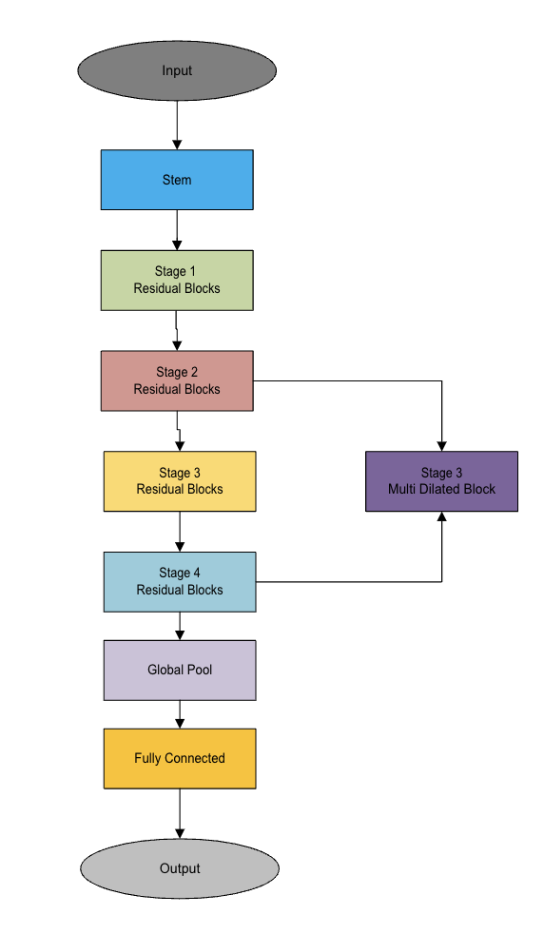
Methodology – Model Architecture
MedicalCNN:
129 layers in total
~22.5 million parameters
combination of A convolutional stem (Conv → BN → ReLU → MaxPool)
4 sequential residual stages (ResNet-style)
AMulti-Dilated Block (capturing multi-scale context)
SE attention modules within residual blocks
A deep, regularized MLP head with BatchNorm + Dropout
Global average pooling before classification

Slide 11
Methodology – Parallelization Techniques
Implemented
DDP to train model on CPUs [2,4,8,16,24,32]
DDP to train model on GPUs [2,4] [P100,V100 SXM-2
DDP + AMP to train GPU.
DDP + AMP + Model Parallel GPU.
12.6 hours for serial implementation

Slide 12

03
Analysis & Results

Slide 13
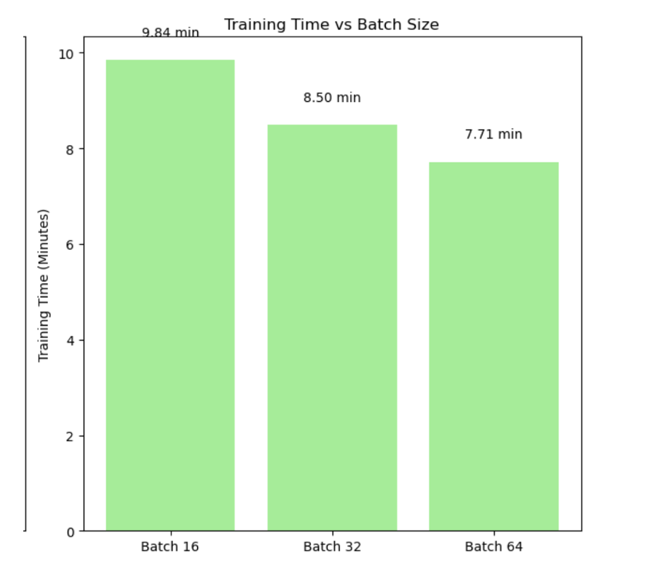
Selecting Batch Size – with Serial data GPU
* Batch Size 64 - Faster Training Time. * Issues with DDP (Batch 64) * Batch Size 32 - Optimal Performance
Inter-Process
Data Transfer
Communication Overhead

Slide 14
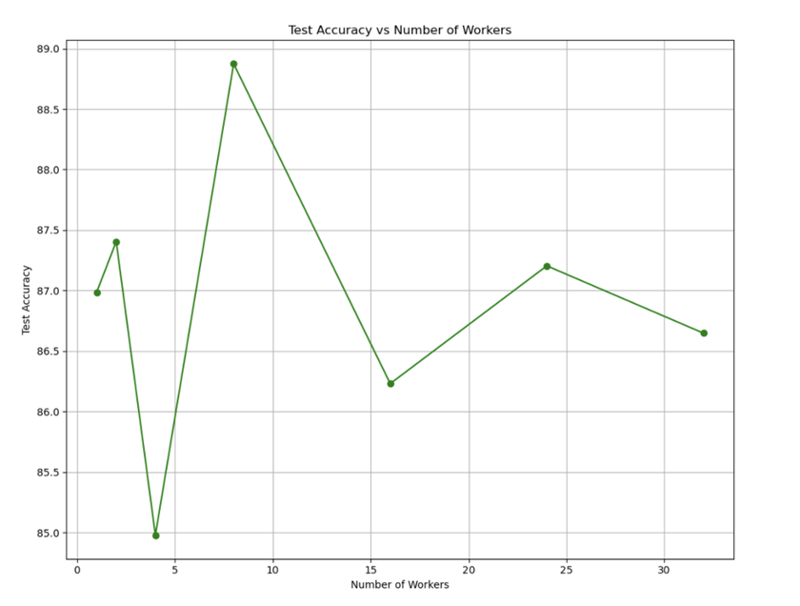
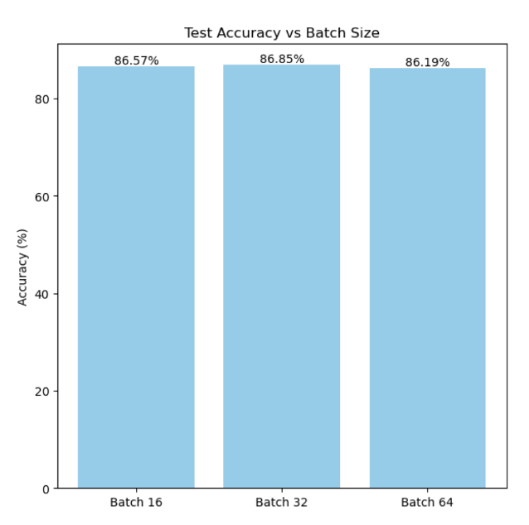
Accuracy
(1) Batch Size 32 - Best Accuracy
(2) Different CPU Configurations - Varying Trends

Slide 15
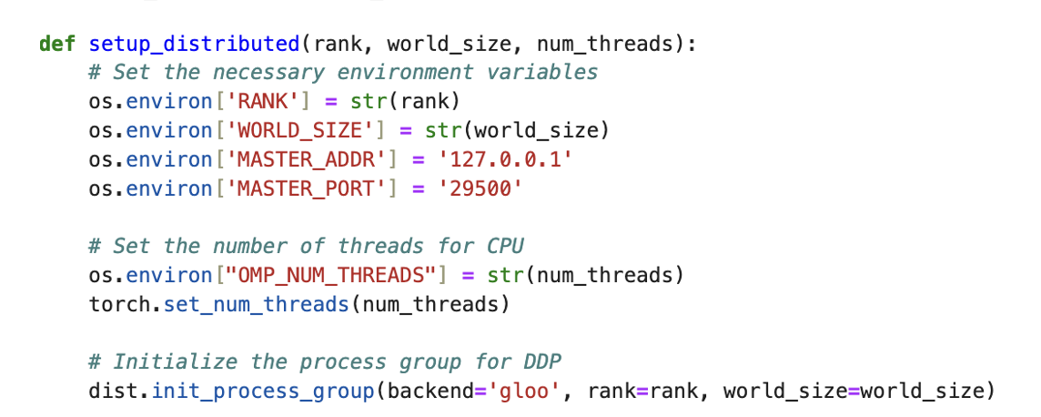
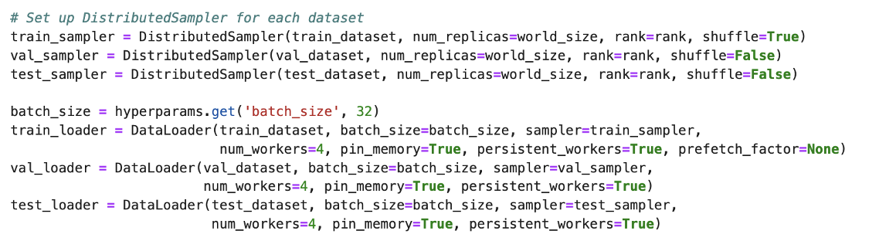
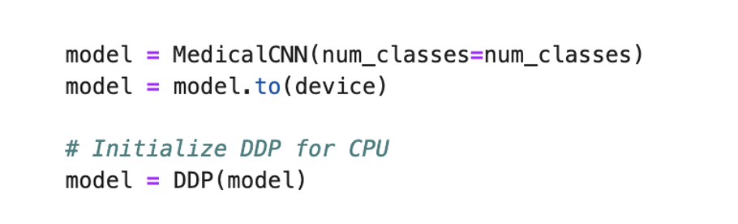
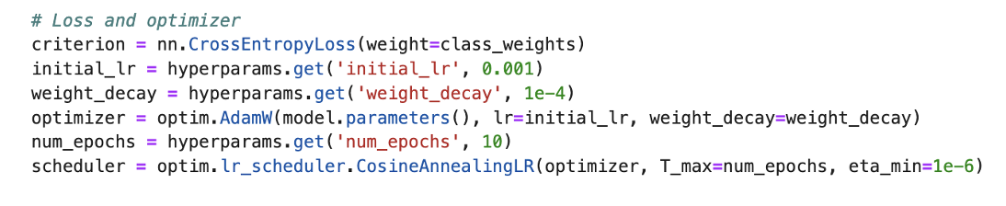
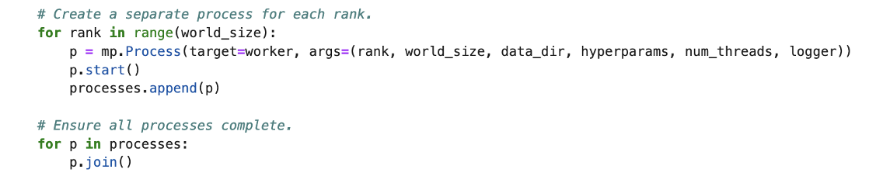
Training Multiple CPUs - DDP
2. DataLoader – Persistent Workers & Prefetch Factor
1. Distributed Initialization
4. Training Loops with Optimizer
3. Model Transfer
5. Spawning up processes

Slide 16
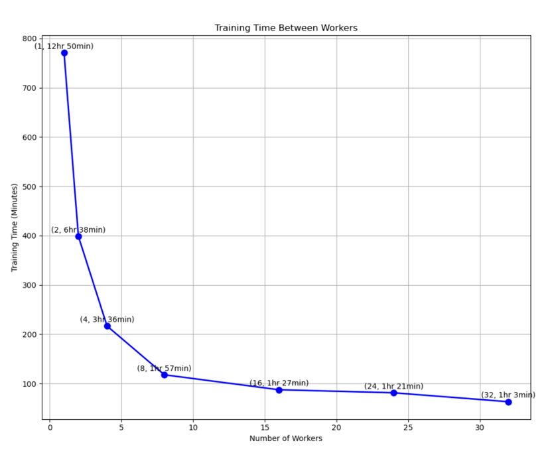
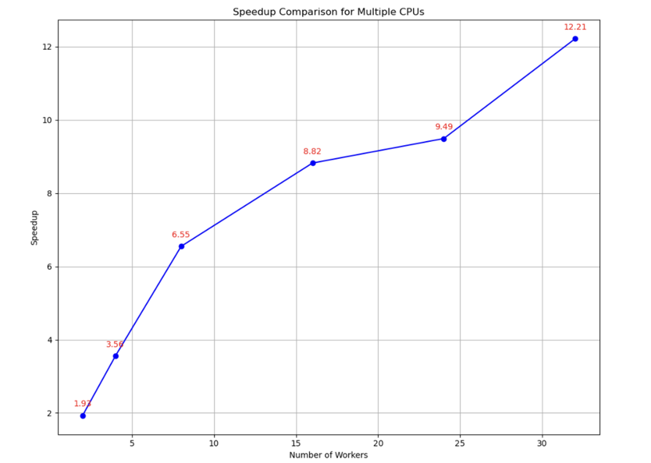
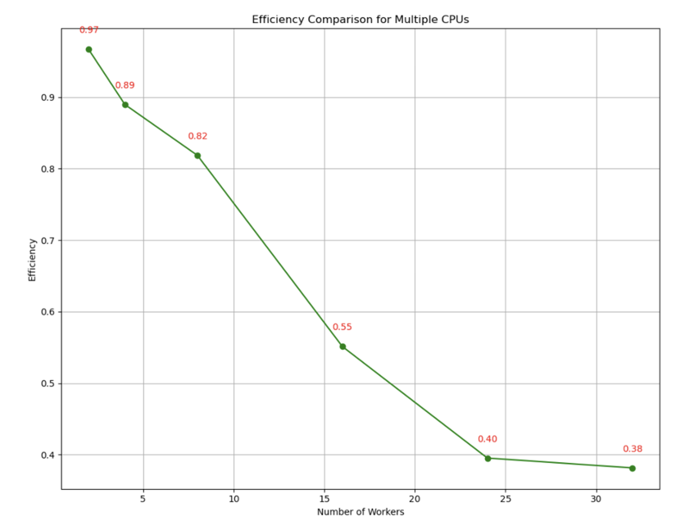
Training Multiple CPUs - DDP
(1) Single CPU training resulted in the longest training times, while using multiple CPUs (4, 8) significantly reduced the training time, with 8 CPUs providing the best overall speed.
(2) As the number of CPUs increased, the speedup was noticeable, particularly with 8 CPUs. However, the gains started to diminish beyond a certain point, indicating a saturation effect.
(3) Efficiency improved with the increase in CPU count, with optimal performance observed at 8 CPUs. However, the efficiency decreased slightly as more CPUs were added, suggesting diminishing returns beyond 8 CPUs.

Slide 17
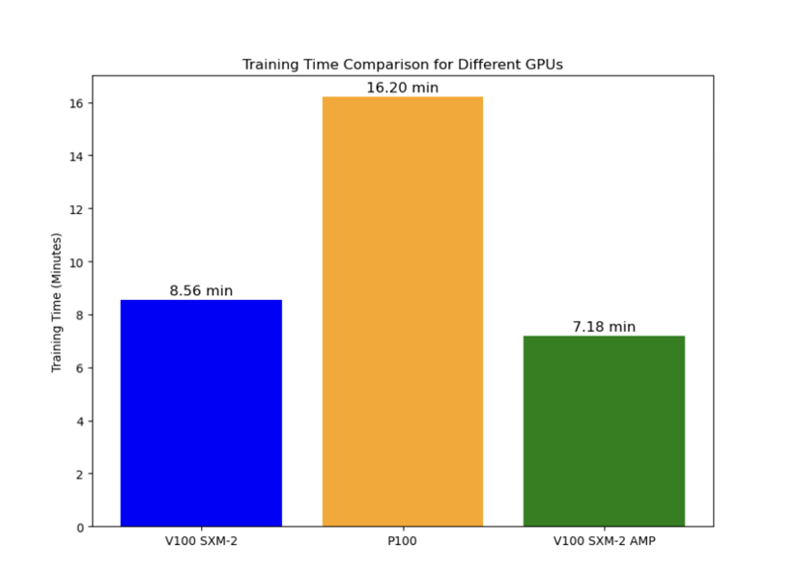
GPUs Comparison -Serial

Slide 18
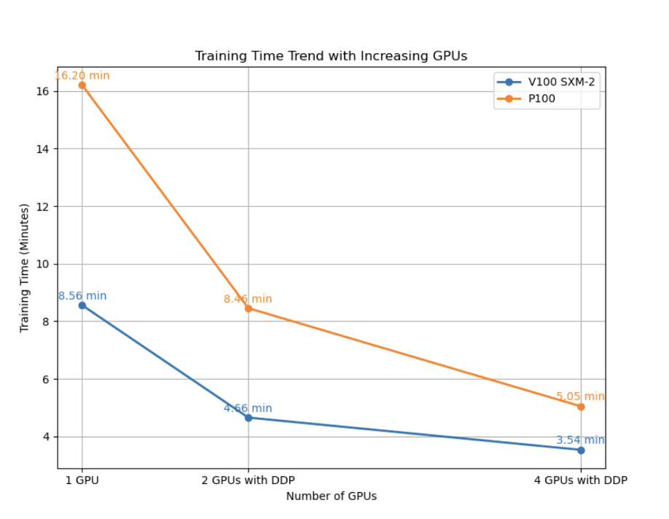
GPUs Comparison – Multi - DDP
(1) Using 2 GPUs with DDP reduces training time (V100: 4.66 min, P100: 8.46 min) compared to single GPU training.
(2) 4 GPUs further reduce training time (V100: 3.54 min, P100: 5.05 min), but the improvement is less significant than moving from 1 to 2 GPUs.
(3) V100 GPUs consistently provide faster training times than P100 across all configurations.
(4) Beyond 2 GPUs, performance improvements become less pronounced, highlighting the diminishing returns of scaling with DDP.

Slide 19
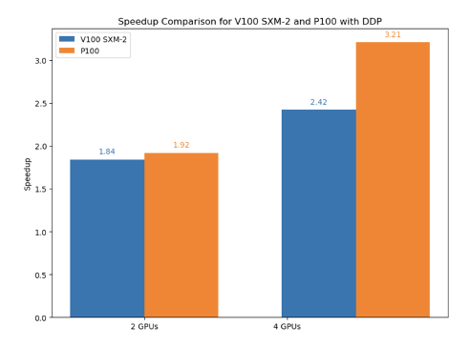
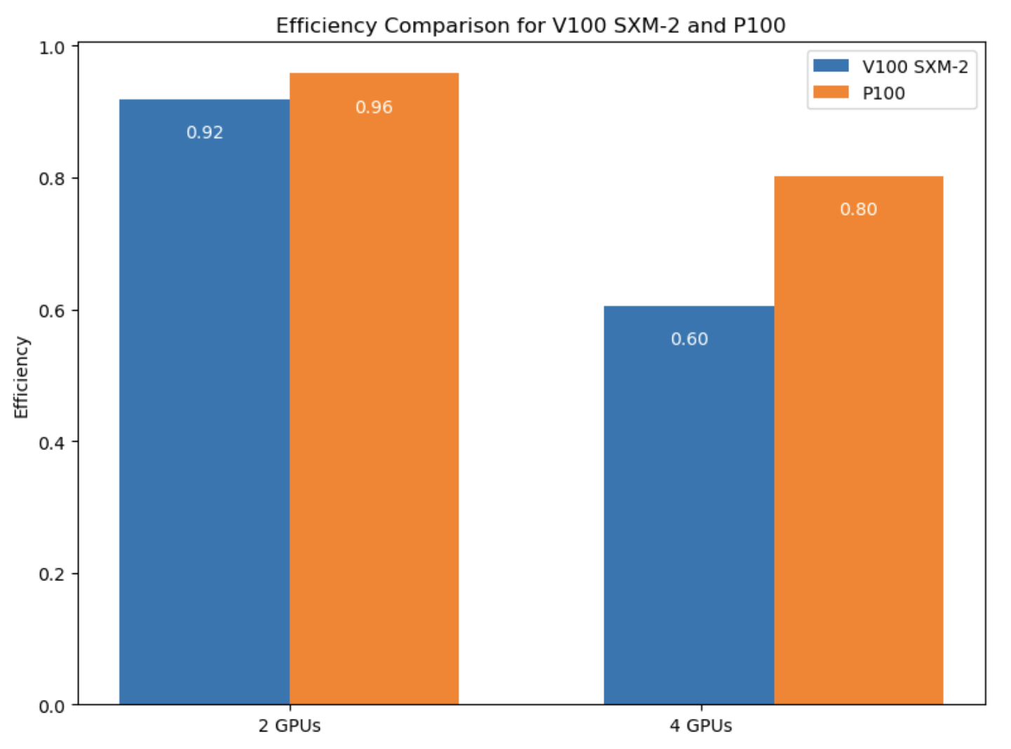
GPUs Comparison – Multi - DDP
(1) The training time shows significant reduction as the number of GPUs increases, with the V100 showing faster results compared to P100. The speedup is more noticeable when transitioning from 1 GPU to 2 GPUs but plateaus when moving to 4 GPUs.
(2) While V100 GPUs demonstrate higher efficiency compared to P100, the efficiency drops slightly as the number of GPUs increases, especially at 4 GPUs. This illustrates the diminishing returns from scaling beyond a certain point.

Slide 20
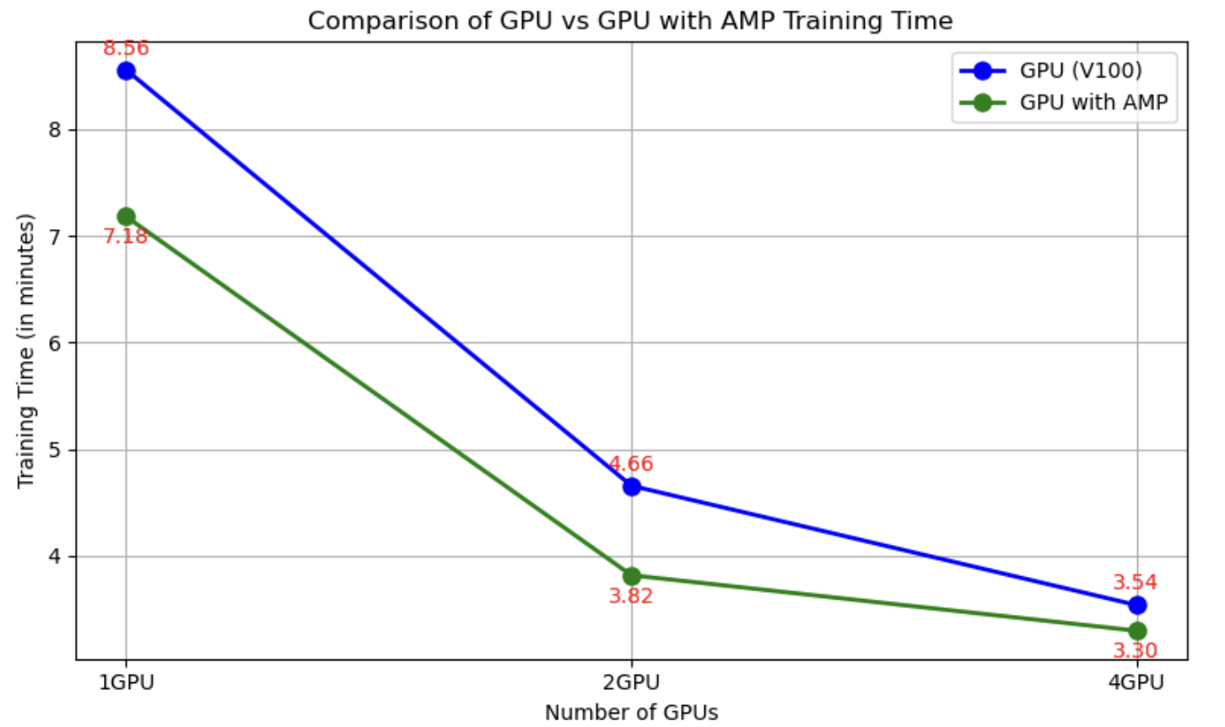
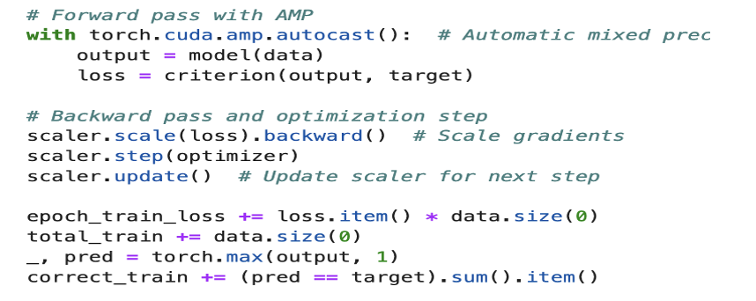
GPUs Comparison – Multi – DDP + AMP
(1) AMPs introduction significantly reduces training time, especially when scaling across multiple GPUs, as shown in the comparison between GPU and GPU with AMP.
(2) AMP offers efficiency gains in the training process, particularly when scaling from 1 GPU to 2 GPUs, making it a valuable tool for optimizing training time while maintaining model accuracy.
(3) Integrating AMP into the training process, using the torch.cuda.amp.autocast() for mixed precision and scaler.scale() to manage gradient scaling for enhanced performance.

Slide 21
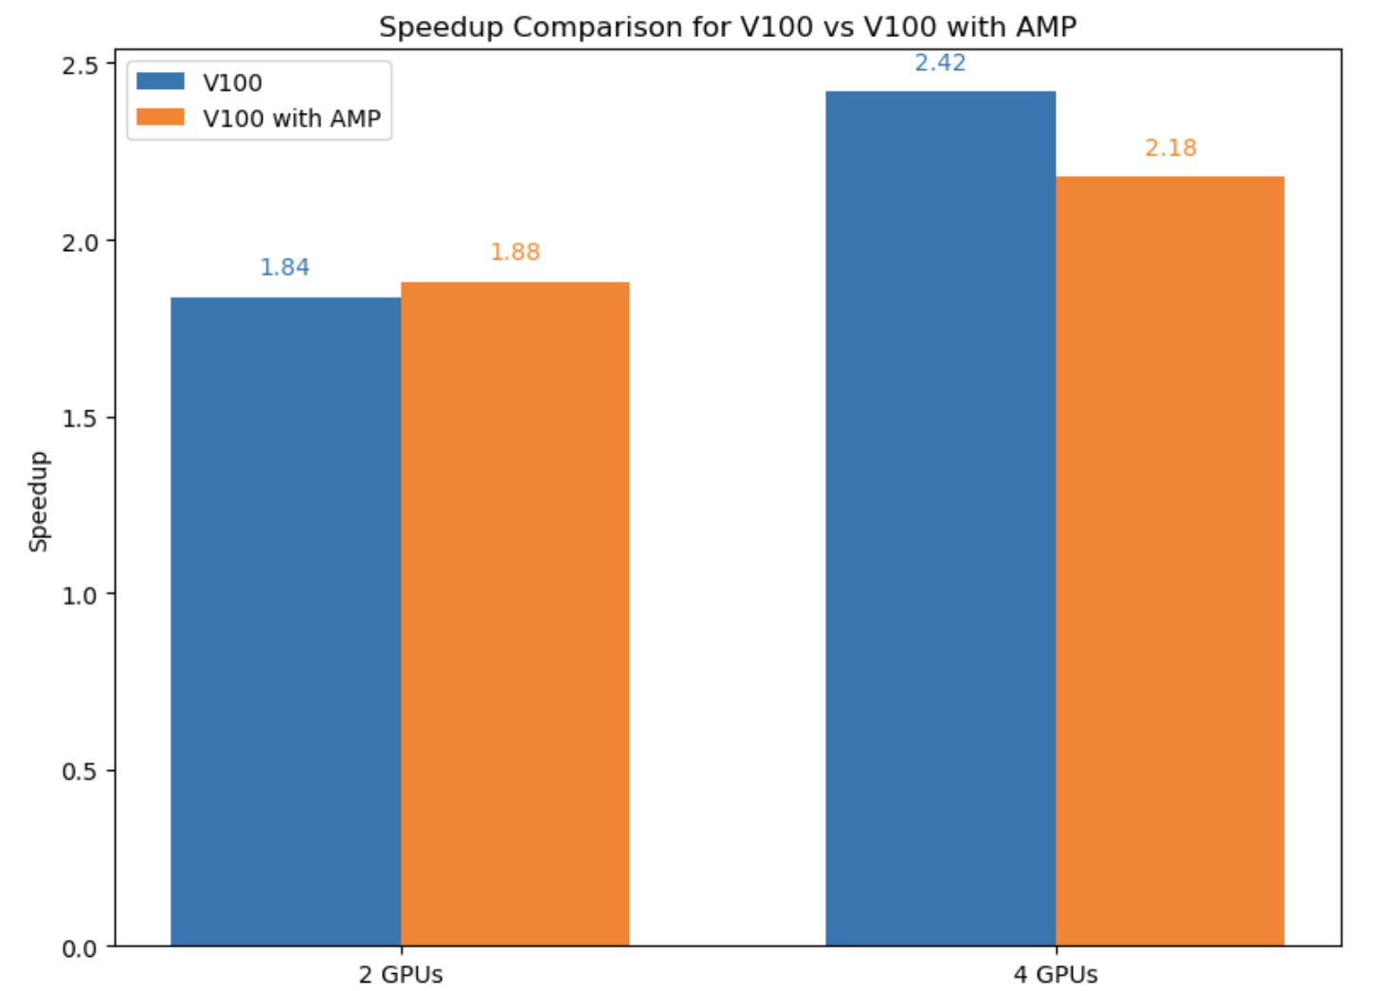
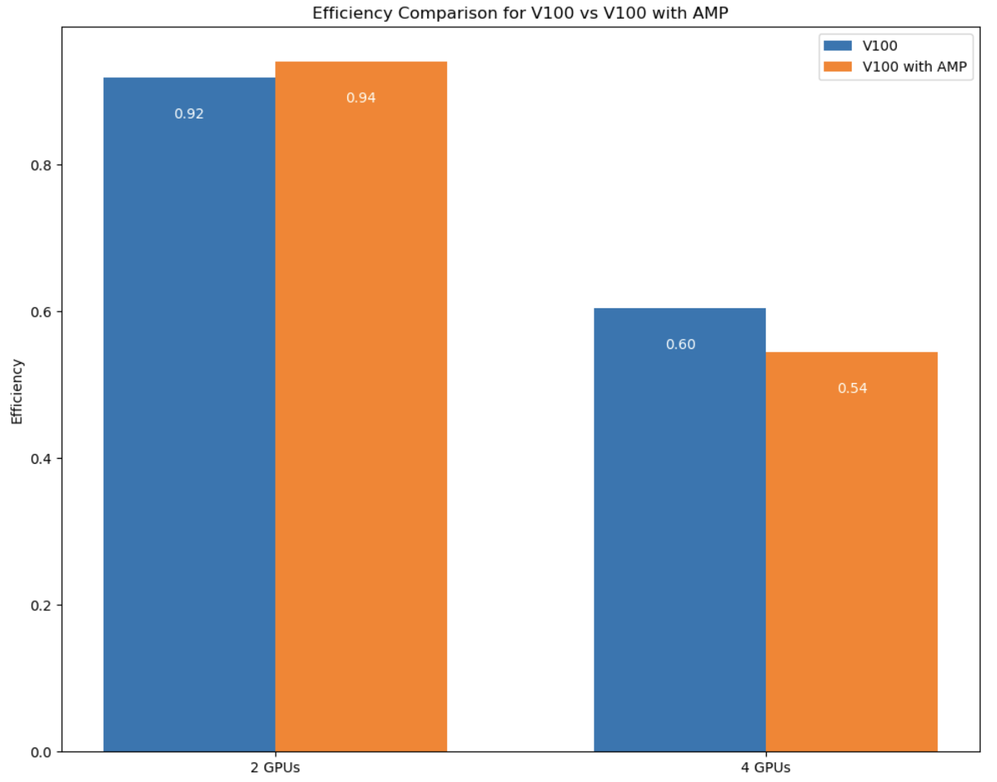
GPUs Comparison – Multi – DDP + AMP
(1) With the use of DDP and AMP, a noticeable speedup is observed in both 2 GPUs and 4 GPUs configurations, with the highest speedup achieved using 4 GPUs and AMP, highlighting the performance gains of parallelization techniques.
(2) Efficiency remains high for 2 GPUs with AMP (0.94) but declines as more GPUs are added. The efficiency for 4 GPUs with AMP drops to 0.54, showing diminishing returns with the added number of GPUs.
(3) While DDP and AMP provide significant speedup, the efficiency analysis indicates that scaling beyond 2 GPUs with AMP may not provide substantial performance benefits for this project, suggesting that 2 GPUs with AMP strikes a good balance between speedup and efficiency.

Slide 22
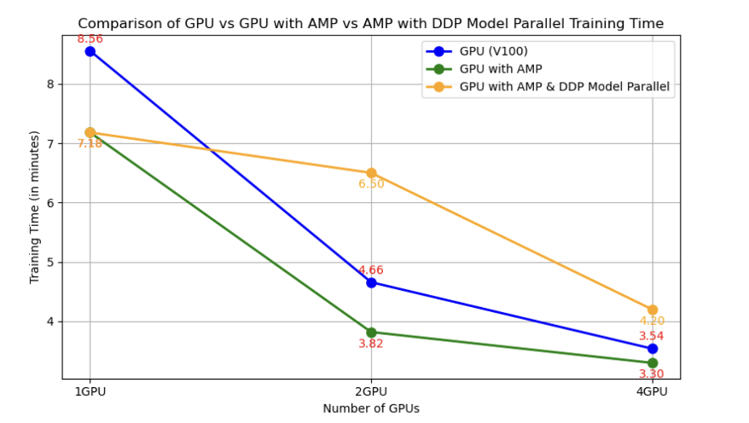
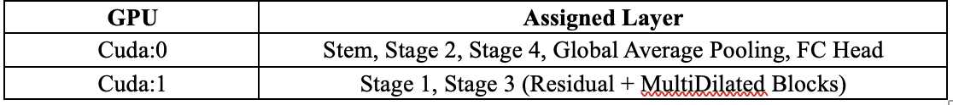
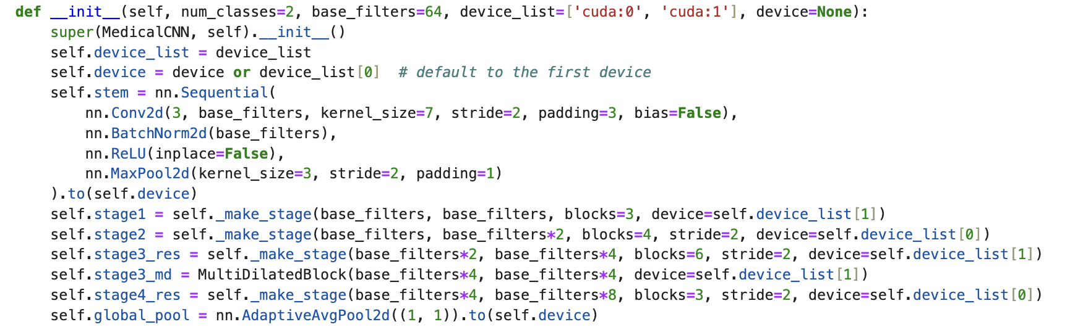
GPUs Comparison – Multi – DDP + AMP + Model Parallel

Slide 23
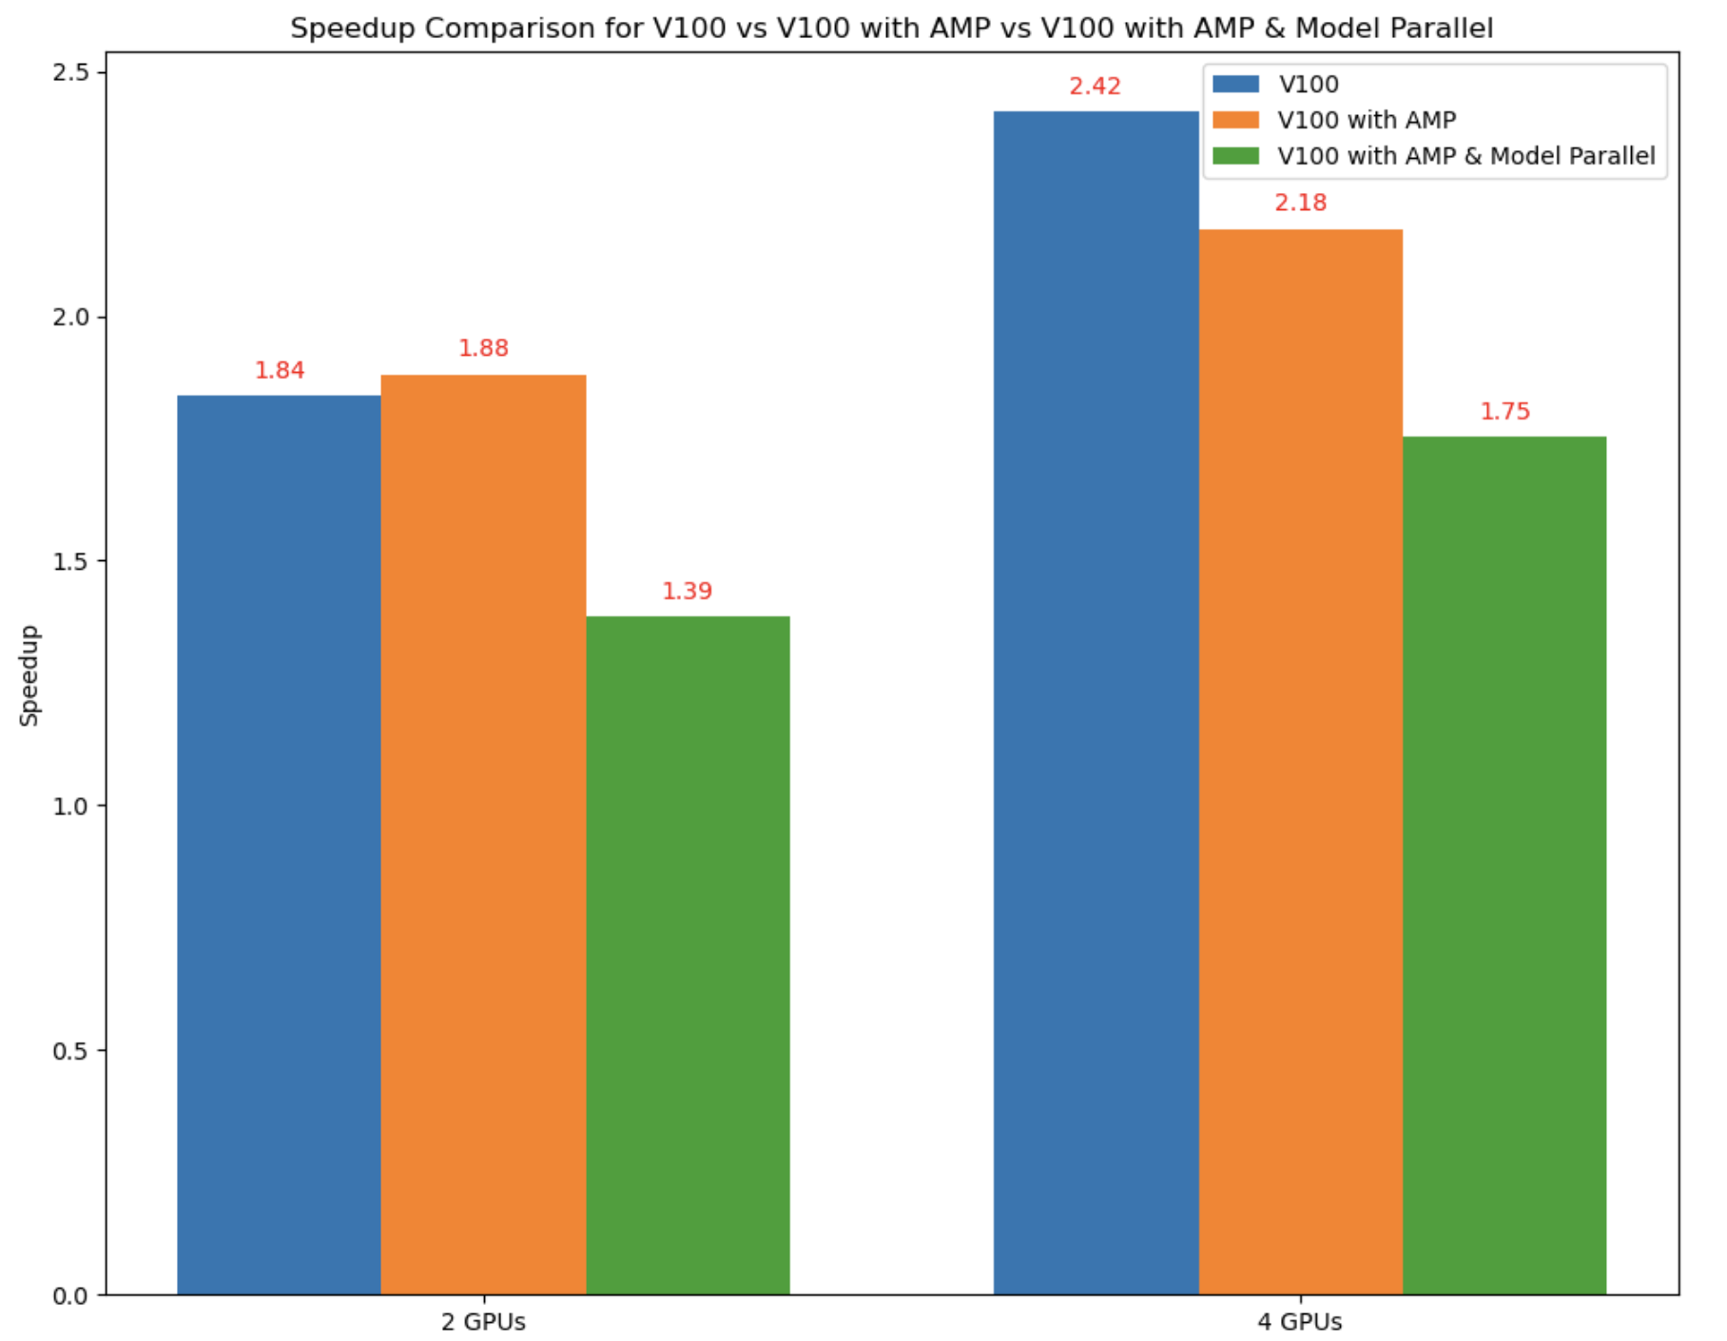
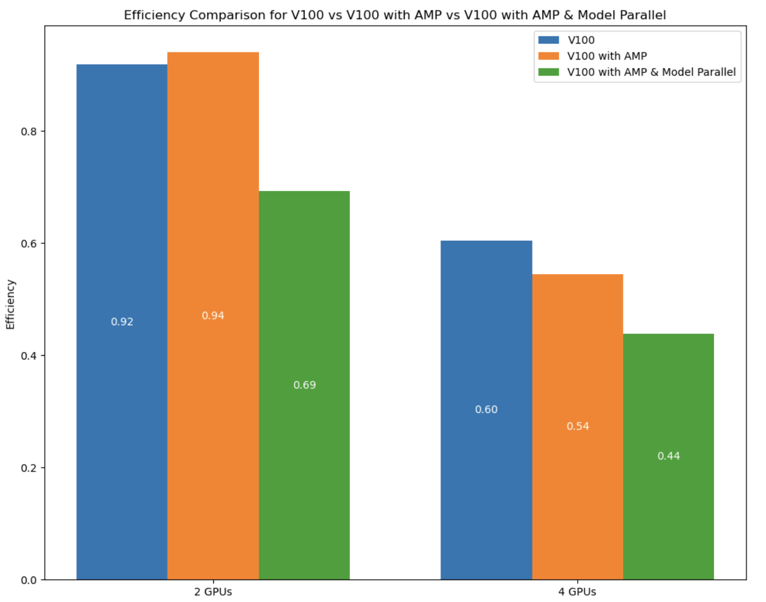
GPUs Comparison – Multi – DDP + AMP
(1) Training time with DDP + AMP + Model Parallel reduces significantly with multiple GPUs, as shown by the improved performance for 2 and 4 GPUs.
(2) While model parallelism improves training efficiency on larger models, the impact is less noticeable for models that can fit in a single GPU's memory.
(3) For smaller datasets, DDP + AMP without model parallelism outperforms configurations with model parallelism in terms of speedup and efficiency.
(4) The added complexity of model parallelism provides diminishing returns when the model is small enough to fit on one GPU, but it can be crucial for larger, more complex architectures that require distributed layer assignment across multiple GPUs.

Slide 24
Conclusion
(1) Optimizing training performance involves balancing batch size, data parallelism, and model parallelism.
(2) DDP + AMP enhances GPU performance, but the gains reduce as the number of GPUs increases.
(3) AMP with a standard configuration offers the best efficiency for smaller models fitting within a single GPU.
(4) For CPU training, using 2-4 workers optimizes performance with reduced training time and maintained efficiency.
(5) V100 with DDP+AMP provides the best combination of training time reduction and high efficiency for GPU setups, while Model Parallelism is not beneficial for this project.

Slide 25
References [1] https://pubmed.ncbi.nlm.nih.gov/24974815/ [2] He, K., Zhang, X., Ren, S., & Sun, J. (2016). Deep Residual Learning for Image Recognition. CVPR 2016. [https://arxiv.org/abs/1512.03385] [3] Hu, J., Shen, L., & Sun, G. (2018). Squeeze-and-Excitation Networks. CVPR 2018. [https://arxiv.org/abs/1709.01507] [4] Chen, L. C., Papandreou, G., Kokkinos, I., Murphy, K., & Yuille, A. L. (2017). Deeplab: Semantic Image Segmentation with Deep Convolutional Nets, Atrous Convolution, and Fully Connected CRFs. PAMI. [https://arxiv.org/abs/1606.00915]
Thank you !!!

